Slide 1

Hyundai Car Price Prediction

Slide 2

TEAM
Aman Kumar (pd16_050)
Arnold Sunny (pd17_133)
Md Zeeshan (pd17_009)
Prashant Murdare (pd16_171)

Slide 3

INTRODUCTION
Predicting the price of a used cars has been studied extensively in various researches.
Car price prediction is somehow an interesting and popular problem.
Accurate car price prediction involves expert knowledge, because price usually depends on many distinctive features and factors.
Typically, the most signiﬁcant ones are present price , brand and model, age, mileage etc. The fuel type used in the car as well as fuel consumption per mile highly affect the price of a car due to a frequent changes in the price of a fuel. Different features like Transmission, tax, Mileage per gallon (mpg), engine size , etc. will also inﬂuence the car price.

Slide 4

PROBLEM STATEMENT
A model to predict the price of a used car should be developed in order to assess its value based on a variety of characteristics. Several factors affect the price of a used car, such as model, year, transmission, Mileage , fuel type, tax, Mileage Per gallon ( mpg) and engine size.
As a result, it is crucial to know the car's actual market value before purchasing or selling it.

Slide 5

SOLUTION APPROACH
Given "hyundai.csv" dataset was loaded into dataframe using python library pandas.
Checked column type and described which columns are numerical or categorical.
We did Exploratory Data Analysis by performing Univariate , Bivariate analysis and plotted various graphs.
By performing one hot encoding we converted categorical columns into numerical one.

Slide 6

SOLUTION APPROACH
We divided Data into Train Data and Test Data and scaled variables.
Trained Multiple models like Linear Regression, Decision Tree, Random Forest, SVR etc.
By Checking performances of each model we found best model for given dataset.
We used Grid Search CV to tune hyperparameter of best model and also trained polynomial regression model.

Slide 7

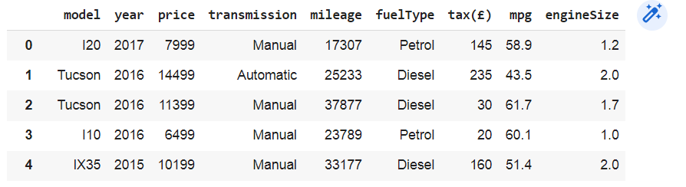
DATASET
We had Dataset of used Hyundai car in United Kingdom

Slide 8
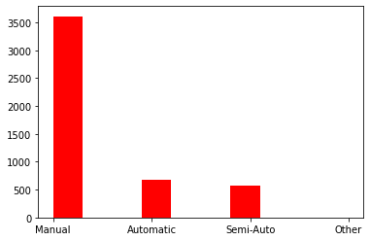
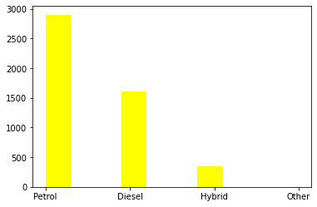
EXPLORATORY DATA ANALYSIS
Histograms Plot for various categorical Data

Slide 9
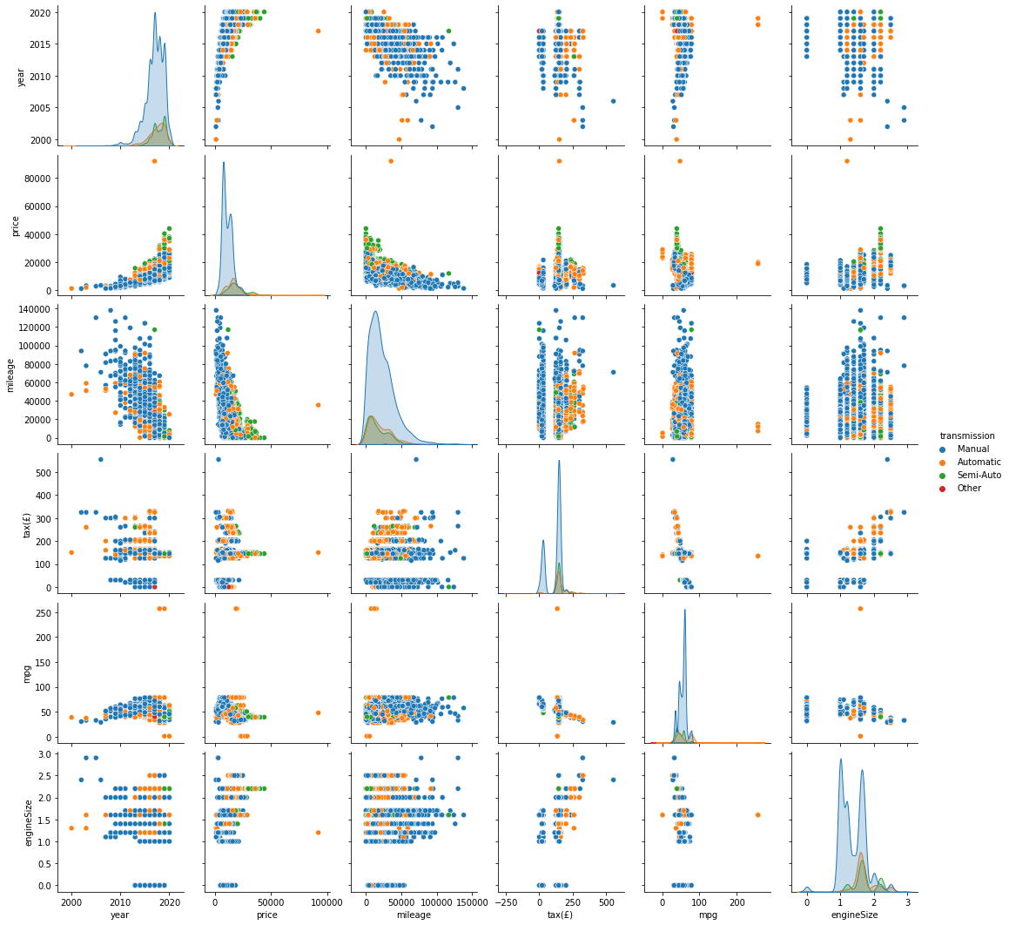
Pairplot

Slide 10
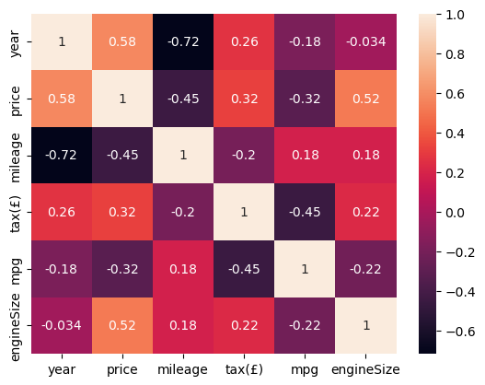
PEARSON CORRELATION COEFFICIENT
We Found out the correlation between various variables by using Pearson Correlation coefficient and also plotted heatmap of it.
Ex: PCC of Year and Price
Pearson Correlation coefficient : 0.58

Slide 11

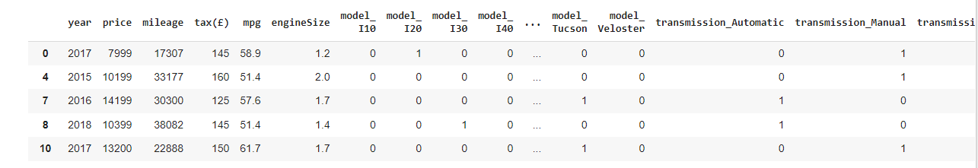
DATA MANIPULATION
As Dataset has numerical and categorical values we encoded categorical into binary values by using one hot encoding method.
Ex: Transmission column separated into Transmission_automatic,Transmission_manual etc

Slide 12

MODEL BUILDING
We trained various model for price prediction -
Linear Regression model
Decision Tree
Random Forest
Support Vector Regression ( SVR)
By applying performance measures like
Accuracy, Root mean square error, R2 Score we
found out best model for given dataset -
Random Forest Model with highest accuracy
Accuracy Score - 92.3 %
R2 Score - 93.04

Slide 13

RESULTS
The Results we can see as follow. The Features are entered and Price is calculated
Features
Model : I20
Year : 2017
Transmission : Manual
Mileage : 17307
FuelType : Petrol
tax : 145 euro
mpg : 58.9
Engine Size : 1.2
Predicted Price of Car - 7999 Euro

Slide 14

CHALLENGES & LEARNING
Finding Best regression model among Linear Regression , Decision Tree , Random Forest and Support Vector Regression(SVR).
We have to learn SVR ( SVR) model since we aren't familiar with it.
Reconstructing given dataset . changing categorical values into numerical form by using one hot encoding.
We learn Team Management and Cohesive teamwork throughout this project.

Slide 15
FUTURE SCOPE
Online Car Marketplaces - With the rise of online car sales platforms accurate and automated price prediction can help buyers and sellers.
Car Rental Companies - can use this model to optimise their pricing strategies and maximize profits.
Insurance Companies - can use this model to better assess the value of a car and provide more accurate insurance rates.
Car Manufacturers - can use this model to better understand market demand for their vehicles and adjust production accordingly.

Slide 16

THANK YOU !
“ Predicting the future isn't magic
It’s Artificial Intelligence.”
- Dave Waters

